Slide 1
2.3.2 Naming in UNIX File System

Slide 2
Outline
UNIX file system
7 layers in file system (3 + 1 + 3)
FS API implementation
OPEN, READ, WRITE, CLOSE, FSYNC

Slide 3
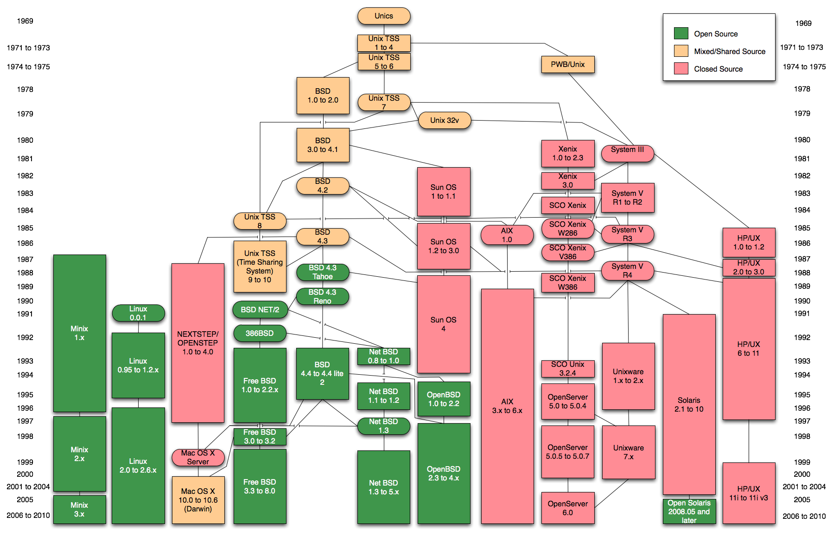
UNIX

Slide 4
File
File is a high-level version of the memory abstraction
A file has two key properties
It is durable & has a name
The system layer implements files using modules from the hardware layer
Divide-and-conquer strategy
several layers of machine-oriented names (addresses), one on another
Maps user-friendly names to these files
In UNIX, everything is a file - KISS

Slide 5
API of the UNIX file system
OPEN, READ, WRITE, SEEK, CLOSE
FSYNC
STAT, CHMOD, CHOWN
RENAME, LINK, UNLINK, SYMLINK
MKDIR, CHDIR, CHROOT
MOUNT, UNMOUNT

Slide 6
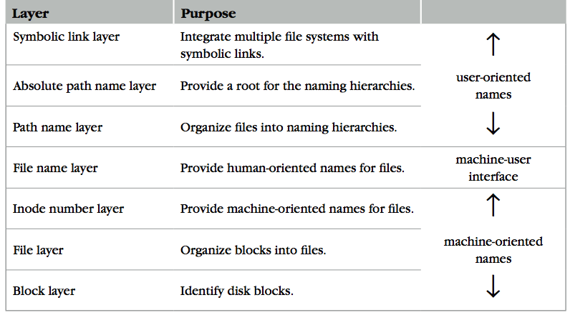
The naming layers of the UNIX file system (version 6)

Slide 7
Disk structure
Sector 0
track2
track1
Sector 1
track0
head 0
Platter
Track
Sector
Head
Cylinder
Cylinder 0
platters
head 1
Cylinder 1
head 2

Slide 8
Block layer
Block num
Block
Block size: a trade-off
Neither too small or too big
Name mapping: block number -> block
Context: the storage device (e.g. disk) itself
Binds block numbers to physical blocks
Name-mapping algorithm
Name discovery: super block
Keep track of block usage: e.g. free list, bitmap
Notes:
What is the relationship between block and sector?

Slide 9
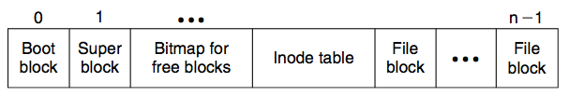
block array

Slide 10

Super block
Block num
Block
One superblock per file system
Kernel reads superblock when mount the FS
Superblock contains
Size of the blocks
Number of free blocks
A list of free blocks
Index to next free block
Lock field for free block and free inode lists
Flag to indicate modification of superblock
Size of the inode list
Number of free inodes
A list of free inodes
Index to next free inode

Slide 11
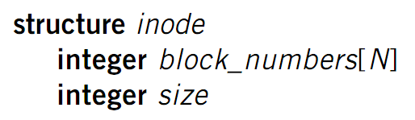
File layer
File
(inode)
Block num
Block
File requirements
Store items that are larger than one block
May grow or shrink over time
A file is a linear array of bytes of arbitrary length
Record which blocks belong to each file
Inode (index node)
A container for metadata about the file

Slide 12
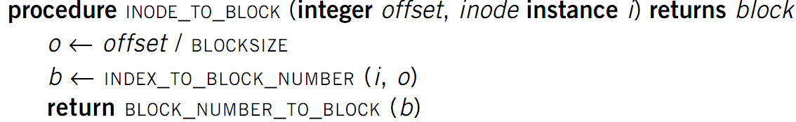
File layer
File
(inode)
Block num
Block
Name mapping: inode number -> block number
Context: the inode itself
Name mapping algorithm
Max length of an offset is 3 bytes in UNIX version 6
What about large files?

Slide 13
Inode number layer
Inode num
File
(inode)
Block num
Block
Name mapping: inode number -> inode
Context: the inode table
Name-mapping algorithm: inode table
At a fixed location on storage
Name discovery
Track which inode number are in use
E.g. free list, a field in inode

Slide 14
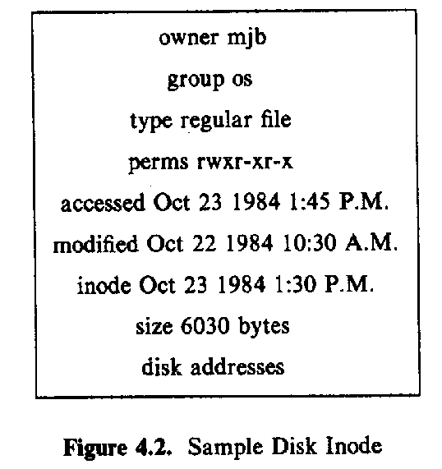
i-node on the disk

Slide 15
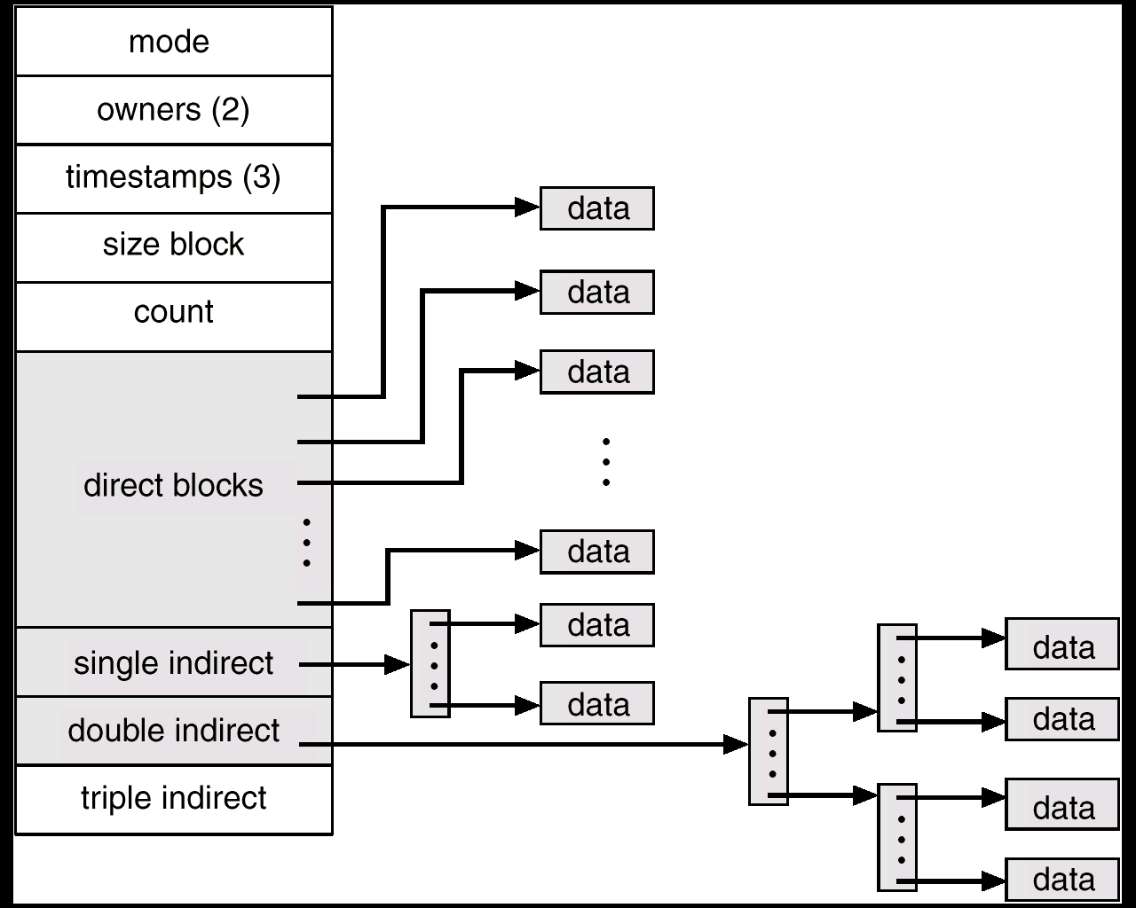
每个文件块1k，1024/4b = 256个间接指向真正的文件块
10个
第十一个

Slide 16
Inode for larger files
File
(inode)
Block num
Block
block
indirect block
double indirect block
976
14
37
inode
16
82
Max length of an offset is 3 bytes in UNIX version 6
Notes:
When N=8, last file would be: (N-1)x256 + 1x256x256 = 32MB

Slide 17
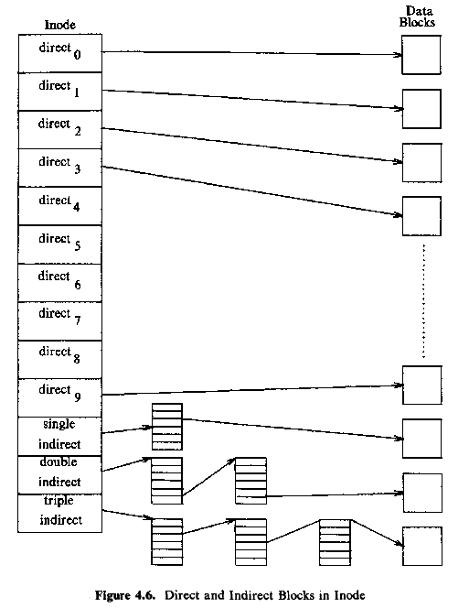

Slide 18
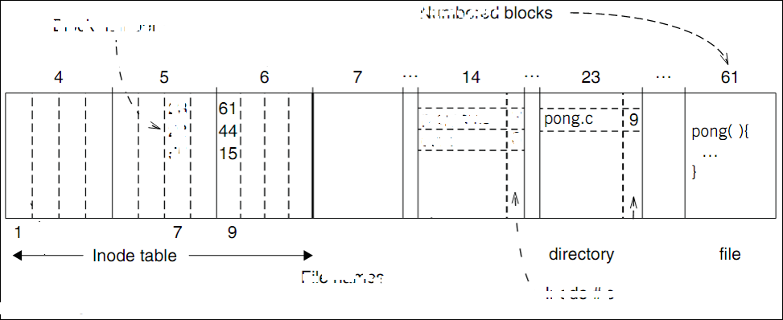
An example: a file’ inode # is 9
Find data of block 61 by its block number
And data of block 44 & 15

Slide 19
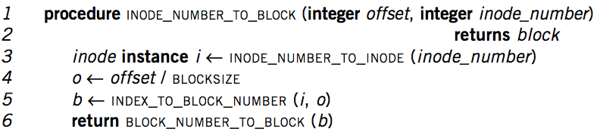
Put layers so far together
Inode num
File
(inode)
Block num
Block
Needs more user friendly name
Numbers are convenient names only for computer
Numbers change on different storage device

Slide 20
Question
1. Bigger UNIX files*
For his many past sins on previous exams, Ben Bitdiddle is assigned to spend eternity maintaining a PDP-11 running version 7 of UNIX. Recently, one of his user’s database applications failed after reaching the file size limit of 1,082,201,088 bytes (approximately one gigabyte). In an effort to solve the problem, he upgraded the computer with an old four gigabyte (2^32 byte) drive; the disk controller hardware supports 32 bit sector addresses, and can address disks up to 2 terabytes in size. Unfortunately, Ben is disappointed to find the file size limit unchanged after installing the new disk.

Slide 21
Question
In this question, the term block number refers to the block pointers stored in i-nodes. There are 512 bytes in a block. In addition, Ben’s version 7 UNIX system has a file system that has been expanded from the one described in section 2.5: its inodes are designed to support larger disks.
to be continued

Slide 22
Question
Each i-node contains 13 block numbers of 4 bytes each
The first 10 block numbers point to the first 10 blocks of the file, with the remaining 3 are used for the rest of the file
The 11th block number points to an indirect block, containing 128 block numbers
The 12th block number points to a double-indirect block, containing 128 indirect block numbers
The 13th block number points to a triple- indirect block, containing 128 double-indirect block numbers
Finally, the inode contains a four-byte file size field

Slide 23
Question
Which of the following adjustments will allow files larger than the current one gigabyte limit to be stored?
A. Increase just the file size field in the i-node from a 32-bit to 64-bit value
B. Increase just the number of bytes per block from 512 to 2048 bytes
C. Reformat the disk to increase the number of i-nodes allocated in the i-node table
D. Replace one of the direct block numbers in each i-node with an additional triple-indirect block number

Slide 24
Question
Ben observes that there are 52 bytes allocated to block numbers in each i-node (13 block numbers at 4 bytes each), and 512 bytes allocated to block numbers in each indirect block (128 block numbers at 4 bytes each).

Slide 25
Question
He figures that he can keep the total space allocated to block numbers the same, but change the size of each block number, to increase the maximum supported file size.
While the number of block numbers in inodes and indirect blocks will change, Ben keeps exactly one indirect, one double-indirect and one triple-indirect block number in each inode.

Slide 26
Question
Q 1.2. Which of the following adjustments (without any of the modifications in the previous question), will allow files larger than the current approximately one gigabyte limit to be stored?
A. Increasing the size of a block number from 4 bytes to 5 bytes
B. Decreasing the size of a block number from 4 bytes to 3 bytes
C. Decreasing the size of a block number from 4 bytes to 2 bytes

Slide 27
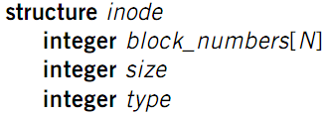
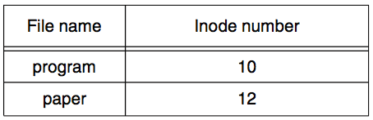
File name layer
File
name
Inode num
File
(inode)
Block num
Block
File name
Hide metadata of file management
Files and I/O devices
Name mapping algorithm
Mapping table saved in directory
Default context: current working directory
Context reference is also inode number
The directory itself is a file
Max length of a name is 14 bytes in UNIX version 6
Notes:
CHDIR can set working directory

Slide 28
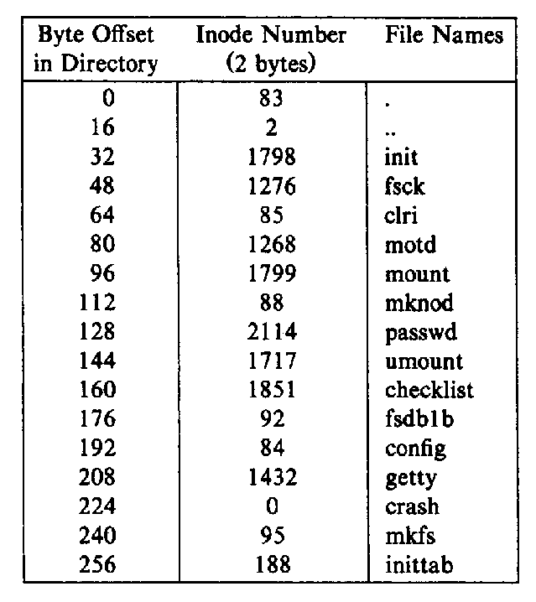
Directory content
linux里面的扩展名属于文件名一部分
已删除
Notes:
here, the directory file is a record file
ls列出目录下的名字。
ls-l列出目录下名字和元数据（访问inode数据结构）。
但是，如果一个目录的可执行权限被关闭，那么就不可以根据目录内的文件inode进行跳转。比如如果上述表格中有文件所在目录没有可执行权限，那么就不能通过上表来跳转到该文件。
/usr/bin/is绝对路径
./work/wl/a.out或者work/wl/a.out是相对路径
DNS： domain name system

Slide 29
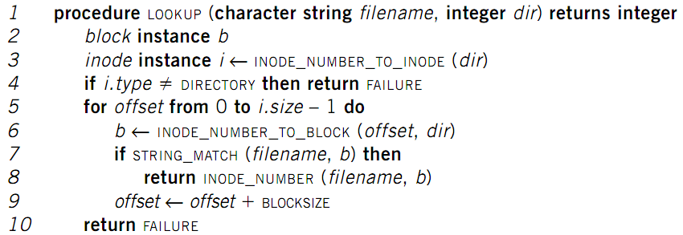
LOOKUP in a directory
File
name
Inode num
File
(inode)
Block num
Block
Name compare method: STRING_MATCH
LOOKUP(“program”, dir) will return 10

Slide 30
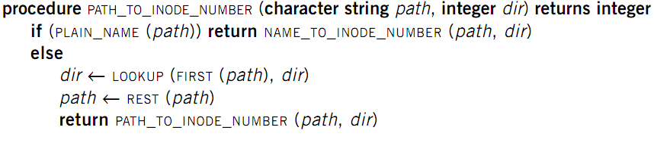
Path name layer
File
name
Inode num
File
(inode)
Block num
Block
Path name
Hierarchy of directories and files
Structured naming: E.g. “projects/paper”
Name-mapping algorithm
PLAIN_NAME returns true if no ‘/’ in the path
Context: the working directory

Slide 31

Absolute path name layer
Absolute path
File
name
Inode num
File
(inode)
Block num
Block
Path name
HOME directory
Every user’s default working directory
Problem: no sharing of HOME files between users
Context: the root directory
A universal context for all users
Well-known name: ‘/’
Both ‘/.’ and ‘/..’ are linked to ‘/’

Slide 32
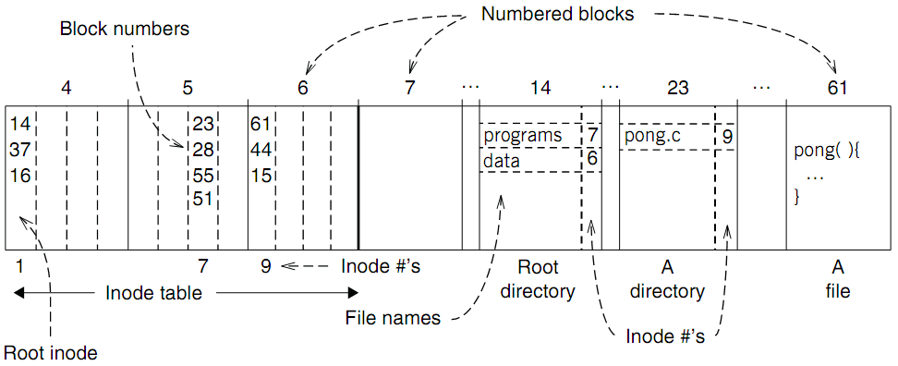
An example: find blocks of “/programs/pong.c”

Slide 33
“/programs/pong.c”

Slide 34
An example: find blocks of “/programs/pong.c”
‘/’ root directory: inode is 1

Slide 35
An example: find blocks of “/programs/pong.c”
Find the first directory in ‘/’ by block number

Slide 36
An example: find blocks of “/programs/pong.c”
Find ‘/programs’ by comparing name

Slide 37
An example: find blocks of “/programs/pong.c”
Find ‘/programs’ inode by its inode number 7

Slide 38
An example: find blocks of “/programs/pong.c”
Find the first file in ‘/programs/’

Slide 39
An example: find blocks of “/programs/pong.c”
Find ‘/programs/pong.c’ by comparing its name

Slide 40
An example: find blocks of “/programs/pong.c”
Find inode of ‘/programs/pong.c’ by the inode number 9

Slide 41
An example: find blocks of “/programs/pong.c”
Find block number of ‘/programs/pong.c’

Slide 42
An example: find blocks of “/programs/pong.c”
Find data of block 61 by its block number
And data of block 44 & 15

Slide 43
Links
File
name
Inode num
File
(inode)
Block num
Block
Path name
LINK: shortcut for long names
LINK(“Mail/inbox/new-assignment”, “assignment”)
Turns strict hierarchy into a directed graph
Users cannot create links to directories -> acyclic graph
Different names, same inode number
UNLINK
Remove the binding of filename to inode number
If UNLINK last binding, put inode/blocks to free-list
A reference counter is needed

Slide 44
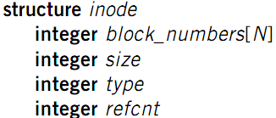
Links
File
name
Inode num
File
(inode)
Block num
Block
Path name
Reference count
An inode can bind multiple file names
+1 when LINK, -1 when UNLINK
A file will be deleted when reference count is 0
WARN: violation of the principle of least astonishment
No cycle allowed
Except for ‘.’ and ‘..’
Naming current and parent directory with no need to know their names

Slide 45
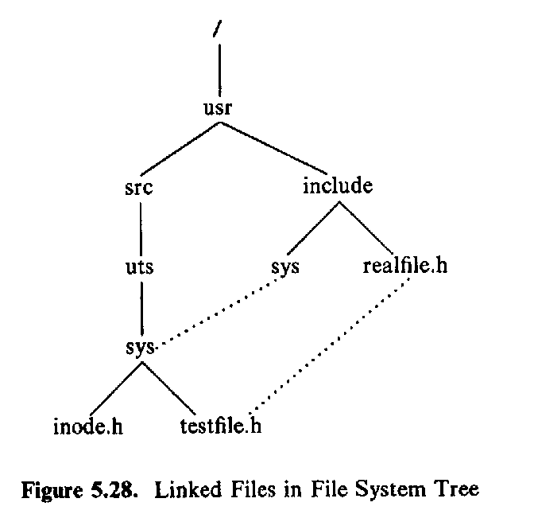
link
link(source, target)
Notes:
hardlink只能在一个文件系统起作用，如硬盘有多块分割分区，每个分区都有9号inode，此时hardlink'就不能用，只能用softlink

Slide 46
No cycle for LINK
File
name
Inode num
File
(inode)
Block num
Block
Path name
/
/
/
a
a
a
25:1
25:2
25: 1
b
c
b
c
b
/a/b is a directory
The refcnt of a is 1
a’s inode num is 25
LINK (“/a/b/c”, a”)
Cause a cycle!
Refcnt of a is 2
UNLINK (“/a”)
Refcnt of a is 1, so the inode 25 is not deleted
Now inode 25 is dis-connected from graph

Slide 47
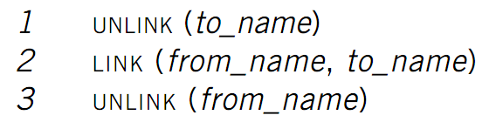
Renaming - 1
File
name
Inode num
File
(inode)
Block num
Block
Path name
Text edit usually save editing file in a tmp file
What if the computer fails between 1 & 2?
to_name will be lost, which surprises the user
Need atomic action in chap-9
Weaker specification
if to_name already exist, it will already exist even if machine fails between 1 & 2

Slide 48

Renaming - 2
File
name
Inode num
File
(inode)
Block num
Block
Path name
Modern version (weaker version)
Changes the inode number in the directory entry for to_name to the inode number of from_name
Removes the directory entry for from_name
If fails between 1 & 2, must increase reference count of from_name’s inode on recovery

Slide 49
Symbolic link layer
Symbolic link
Absolute path
File
name
Inode num
File
(inode)
Block num
Block
Path name
MOUNT
Records the device and the root inode number of the file system in memory
Record in the in-memory version of the inode for “/dev/fd1” its parent’s inode
UNMOUNT undoes the mount
Change to the file name layer
If LOOKUP runs into an inode on which a file system is mount, it uses the root inode of that file system for the lookup

Slide 50
Symbolic link layer
Symbolic link
Absolute path
File
name
Inode num
File
(inode)
Block num
Block
Path name
Name files on other disks
Inode is different on other disks
Supports to attach new disks to the name space
Two options
Make inodes unique across all disks
Create synonyms for the files on the other disks
Soft link (symbolic link)
SYMLINK
Add another type of inode
Context: the directory hierarchy
Notes:
符号连接在windows里面是4k，我们可以看到快捷方式大小都是4k，即块的大小为4k。

Slide 51
Two types of links (synonyms)
Add link “assignment” to “Mail/new-assignment”
Hard link
No new file is created, just add a binding between a string and an existing inode
Target inode reference count is increased
If target file is deleted, the link is still valid
Soft link
A new file is created, the data is the string “Mail/new-assignment”
Target inode reference count is not increased
If target file is deleted, the link is not valid
Soft link can create cycle by SYMLINK(“a”, “a”)

Slide 52
Symbolic link layer
Another interesting behavior of soft link
Current directory is “/Scholarly/programs/www”
This wd contains a soft link
“CSE2011-web” -> “Scholarly/programs/www”
Run following commands
CHDIR (“CSE2011-web”)
CHDIR (“..”)
What is the current directory?
“..” is resolved in the new default context

Slide 53
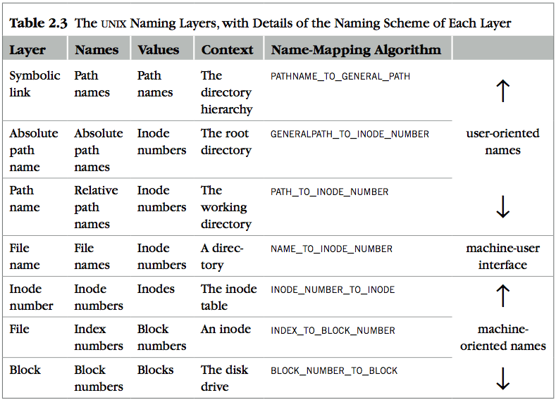
Decouple modules with indirection

Slide 54
Implementing the file system API
Review
CHDIR, MKDIR
LINK, UNLINK, RENAME
SYMLINK
MOUNT, UNMOUNT
Next
OPEN, READ, WRITE, CLOSE
FSYNC

Slide 55
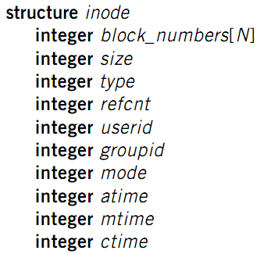
File meta-data
Owner ID
User ID and group ID that own this inode
Types of permission
Owner, group, other
Read, write, execute
Time stamps
Last access (by OPEN)
Last modification (by WRITE)
Last change of inode (by LINK)

Slide 56
OPEN file
Check user’s permission
Update last access time
Return a short name for a file
fd: file descriptor
Used by READ, WRITE, CLOSE

Slide 57
File cursor sharing
fd_table
file_table
fd
index
index
inode num
file cursor
refcnt
Process A
3
115
115
23
128
1
116
23
240
2
fd
index
Process B
3
116
...
fd
index
C is B’s child
3
116
Process A, B and C all open just one file with inode number 23
Process A and B open the same file, not share file cursor
Process A and C share the file cursor

Slide 58
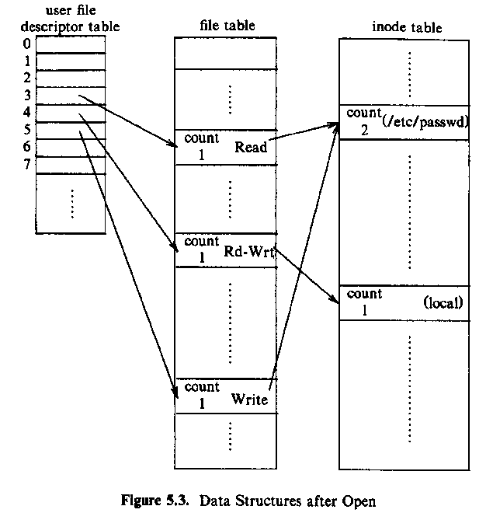

data structure of opened files
Notes:
any open

Slide 59
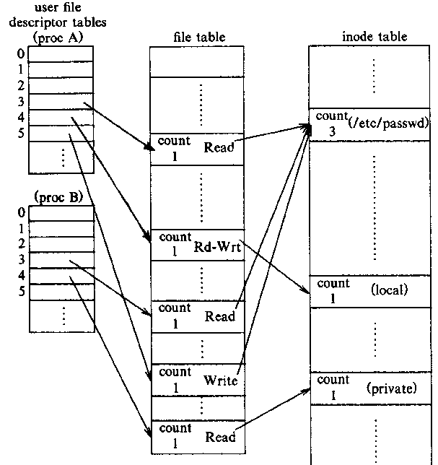
two processes open files
Notes:
fd为3和5的同时访问同一个文件，那么在一个进行操作时候，就要加锁来暂时阻止另一个操作，防止竞争。

Slide 60
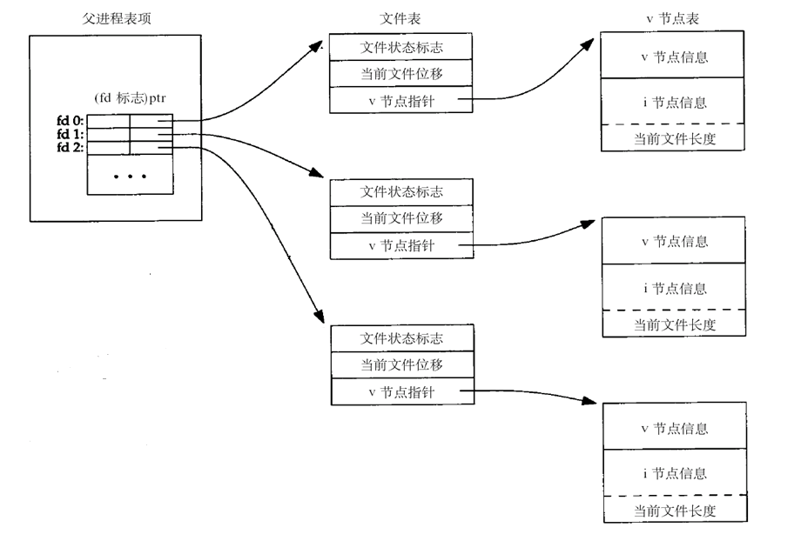
parent、child share file table

Slide 61
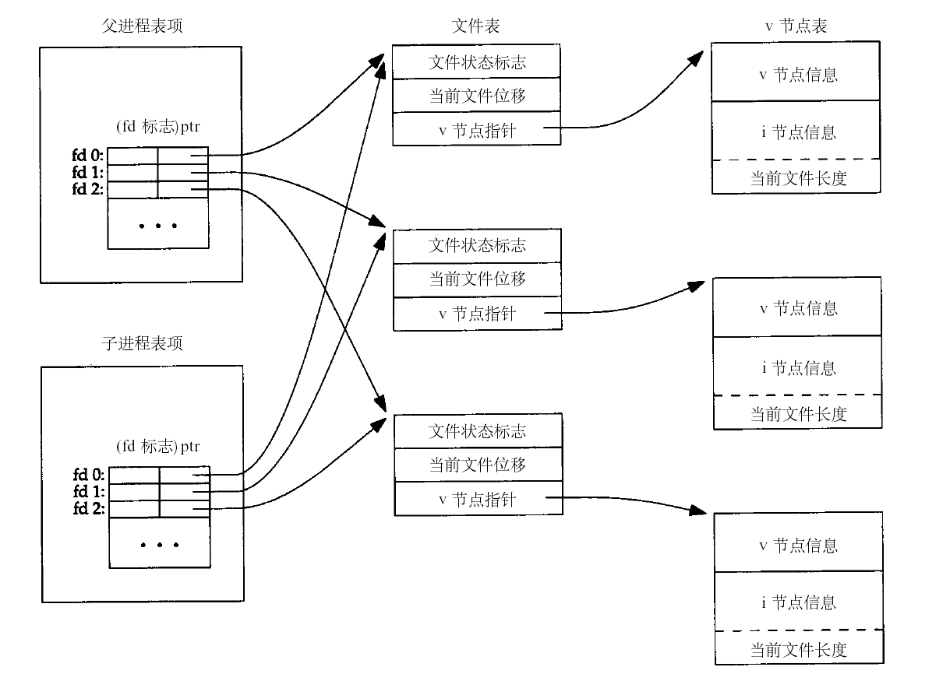
parent、child share file table
Notes:
游标共享

Slide 62
File descriptor
Each process starts with three open files
Standard in: fd = 0
Standard out: fd = 1
Standard error: fd = 2
Can also use fd to name opened devices
Keyboard, display, etc.
Allow a designer not to worry about input/output
Just read from fd 0 and write to fd 1
Each process has its own fd name space

Slide 63
File cursor
File cursor
Keep track of operation position within a file
Sharing cursor
Parent passes its fd to its child
In UNIX, child inherits all open fds from its parent
Allow parent and child to share a output file
Not sharing cursor
Two processes open the same file

Slide 64
fd_table & file_table
One file_table for the whole system
Records information for opened files
Inode number, file cursor, reference count of opening processes
Children can share the cursor with their parent
One fd_table for each process
Records mapping of fd to index of the file_table

Slide 65
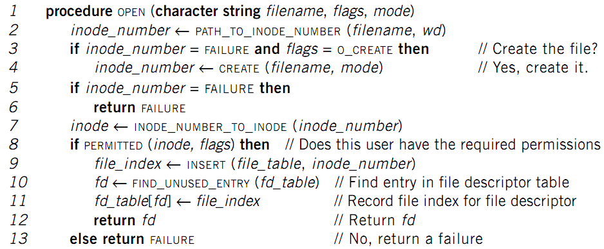
OPEN implementation

Slide 66
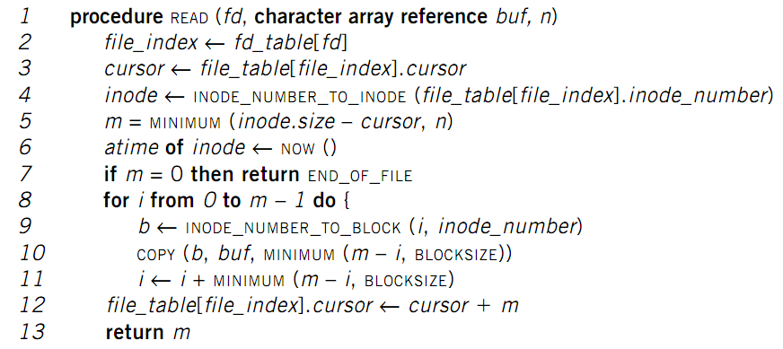
READ implementation

Slide 67
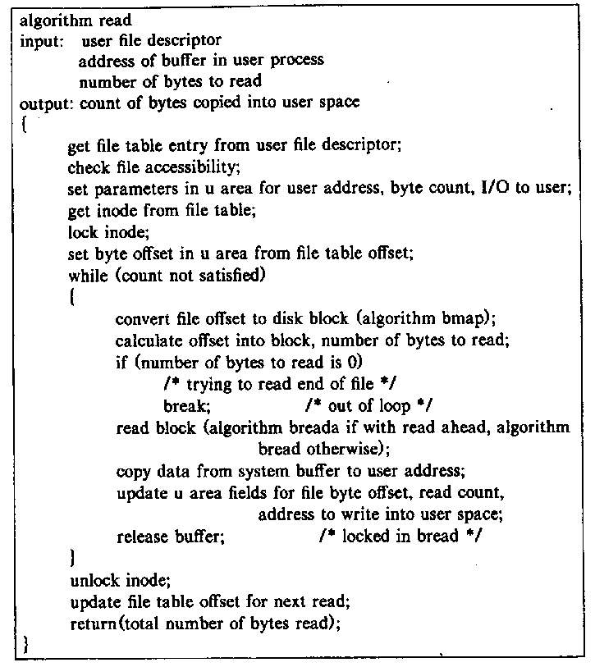
2 read algorithm

Slide 68
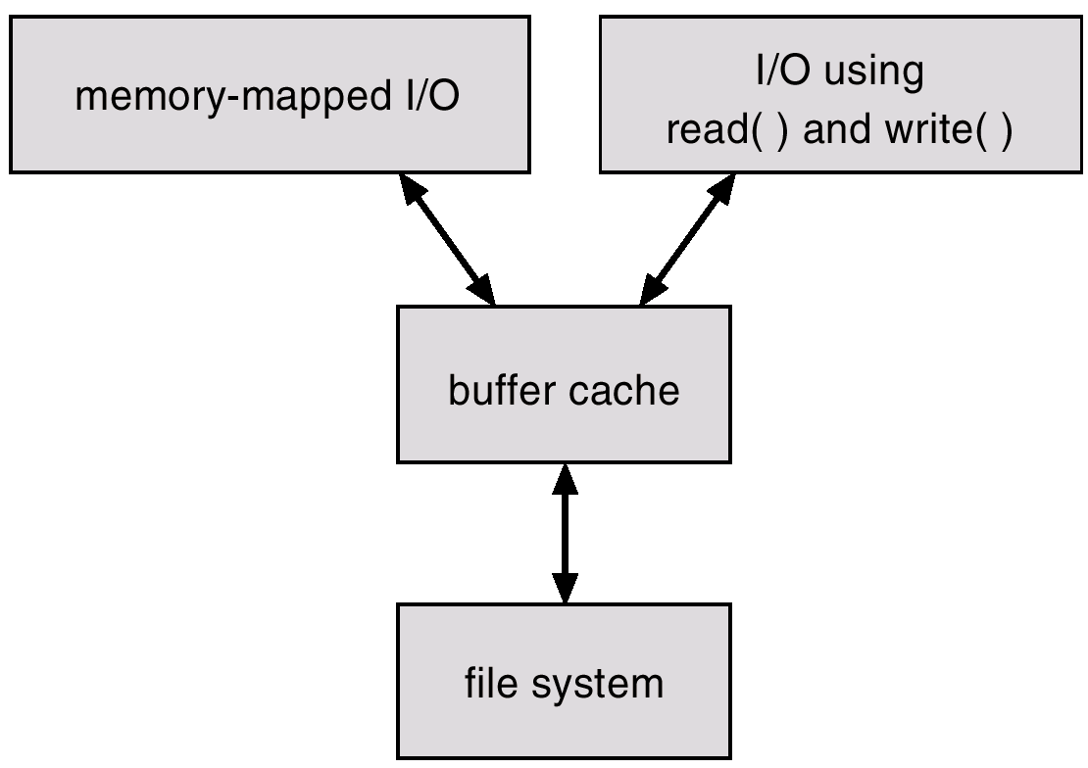
Cache for disk
磁盘系统

Slide 69
FSYNC
Block cache
Cache of recently used disk blocks
Read from disk if cache miss
Delay the writes for batching
Improve performance
Problem: may cause inconsistency if fail before write
FSYNC
Ensure all changes to the file have been written to the storage device

Slide 70
sync, fsync, fdatasync
#include <unistd.h>
int fsync(int filedes);
fsync refers only to a single file, waits for the disk writes to complete before returning
int fdatasync(int filedes);
it affects only the data portions of a file (not inode )
sync(void);
simply queues all the modified block buffers for writing and returns
Notes:
sync在返回的同时后天还在写入磁盘。

Slide 71
Linux ext2 timing results
Operation | User CPU (seconds) | System CPU (seconds) | Clock time (seconds)
read time from Figure 3.5 for BUFFSIZE = 4,096 | 0.03 | 0.16 | 6.86
normal write to disk file | 0.02 | 0.30 | 6.87
write to disk file with O_SYNC set | 0.03 | 0.30 | 6.83
write to disk followed by fdatasync | 0.03 | 0.42 | 18.28
write to disk followed by fsync | 0.03 | 0.37 | 17.95
write to disk with O_SYNC set followed by fsync | 0.05 | 0.44 | 17.95

Slide 72
Mac OS X timing results
Onperation | User CPU (seconds) | System CPU (seconds) | Clock time (seconds)
write to /dev/null | 0.06 | 0.79 | 4.33
normal write to disk file | 0.05 | 3.56 | 14.40
write to disk file with O_FSYNC set | 0.13 | 9.53 | 22.48
write to disk followed by fsync | 0.11 | 3.31 | 14.12
write to disk with O_FSYNC set followed by fsync | 0.17 | 9.14 | 22.12

Slide 73
WRITE & CLOSE
WRITE is similar to READ
Allocate new block if necessary
Update inode’s size and mtime
CLOSE
Free the entry in the fd_table
Decrease the reference counter in file table
Free the entry in file table if counter is 0
Failures in the middle may cause inconsistency
E.g. a block is allocated from on-disk free list, but no inode records that block yet, then the block is lost

Slide 74
Question
When writing, which order is prefered?
Allocate new blocks, write new data, update size
Allocate new blocks, update size, write new data
Update size, allocate new blocks, write new data

Slide 75
Delete after OPEN but before CLOSE
One process has a file open
Another process removes the last name pointing to that file
Reference counter is now 0
The inode isn’t freed until the first process calls CLOSE

Slide 76
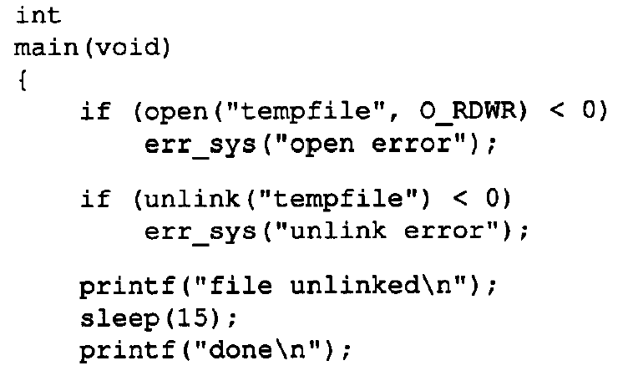
unlink the opened file
fd=
read(fd，WRONLY）
[这样仍然没问题]
open(“tempfile”,...)【出错，有问题】
close（fd）【检查linkcout，启动垃圾回收】
Notes:
即便在read前加入create（‘tempfile“）仍然read的是原来的文件

Slide 77
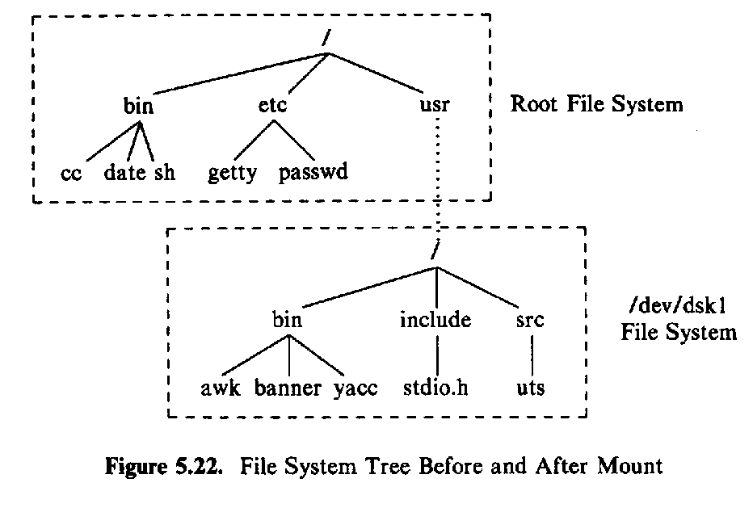
mount
usr
被标记为mount point，标记后就表明不能读原来目录下原本内容，而要读对应分区的内容
Notes:
mount -t type [-o options] device dir
device：指定要挂载的设备，比如磁盘、光驱等。
dir：指定把文件系统挂载到哪个目录。
type：指定挂载的文件系统类型，一般不用指定，mount 命令能够自行判断。
options：指定挂载参数，比如 ro 表示以只读方式挂载文件系统。

Slide 78
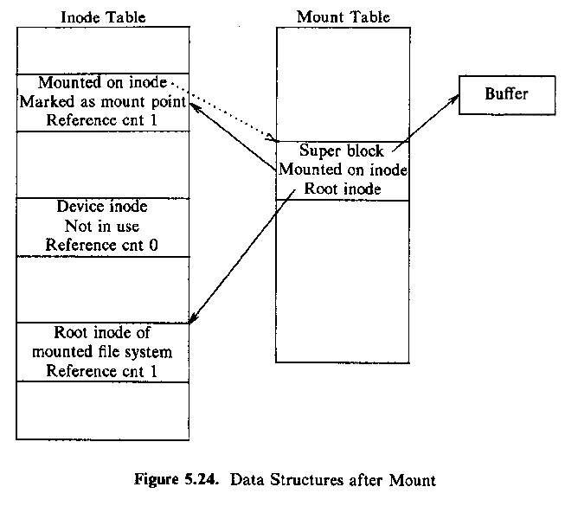
data structures after mount

Slide 79
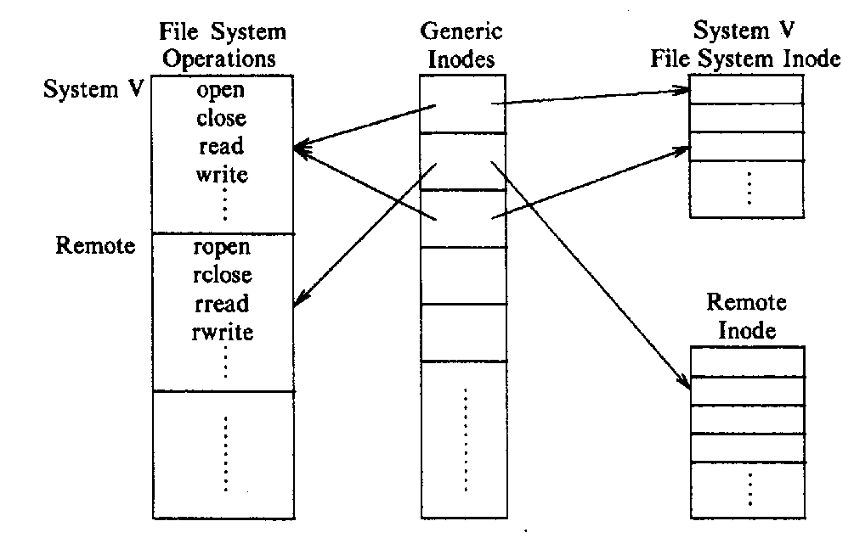
abstract file system

Slide 80
Virtual File Systems
Virtual File Systems (VFS) provide an object-oriented way of implementing file systems.
VFS allows the same system call interface (the API) to be used for different types of file systems.

Slide 81
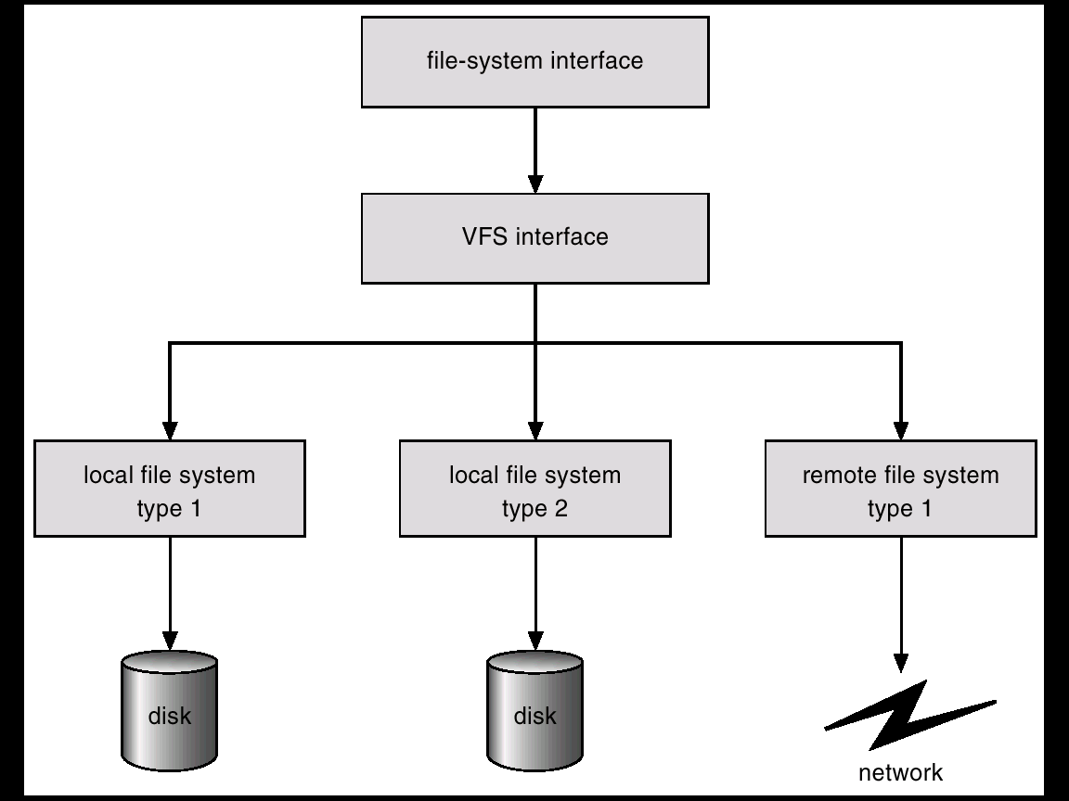
Schematic View of Virtual File System
标准的read，write接口
NFS

Slide 82
NFS
NFS

Slide 83
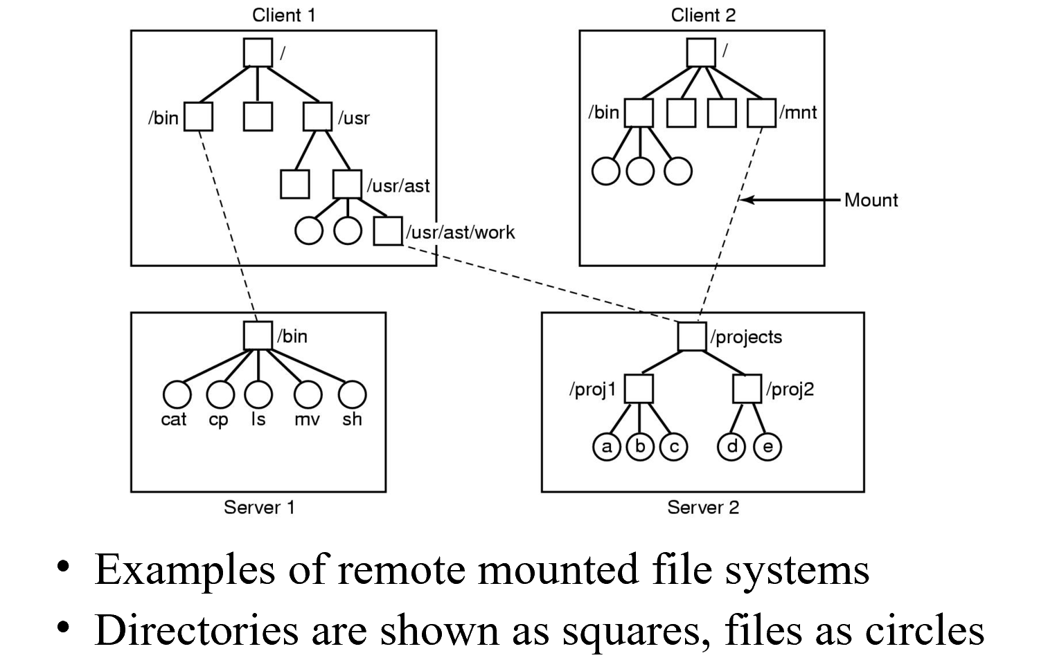
Mounting in NFS
Can be Cascading mounted
Notes:
NFS：支持级联，mount后还可以再mount

Slide 84
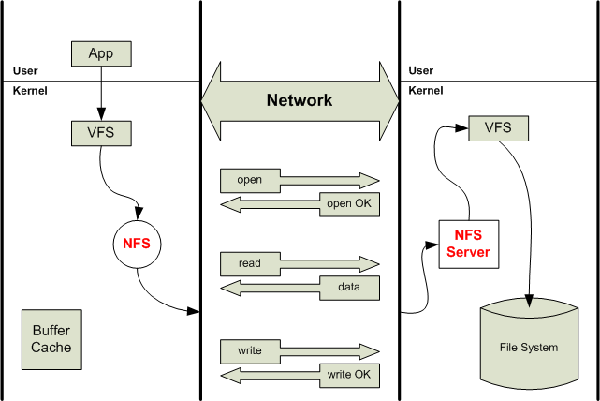
NFS
fd，length
Notes:
从App通过VFS标准接口，然后通过NFS再通过网络发送open指令，另一端进行处理。
假设客户端read发送的fd是服务器端的服务器，会存在问题。然后read也没有buf了，因为只要服务端发过来就好了。

Slide 85
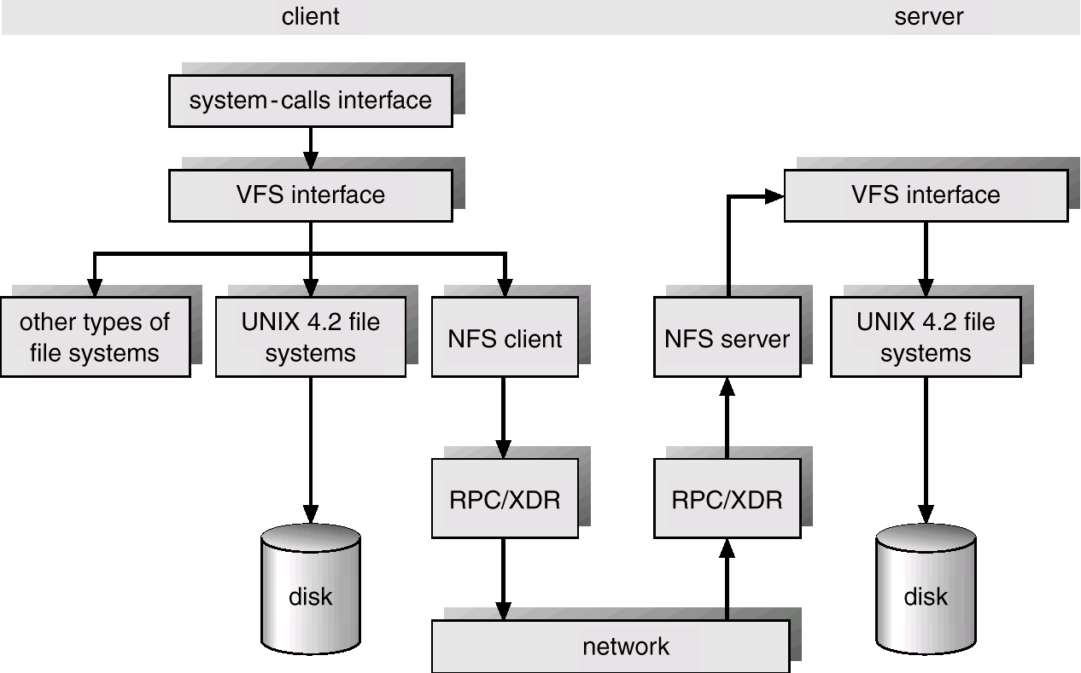
Schematic View of NFS Architecture
Notes:
RPC：完成服务名、网络传输可靠性、服务的问题等等
如果两边分别使用大端法和小端法，也可以在RPC/xdr处理

Slide 86
The Sun Network File System (NFS)
An implementation and a specification of a software system for accessing remote files across LANs (or WANs).
The implementation is part of the Solaris and SunOS operating systems running on Sun workstations using an unreliable datagram protocol (UDP/IP protocol and Ethernet.

Slide 87
NFS (Cont.)
Interconnected workstations viewed as a set of independent machines with independent file systems, which allows sharing among these file systems in a transparent manner.
A remote directory is mounted over a local file system directory. The mounted directory looks like an integral subtree of the local file system, replacing the subtree descending from the local directory.
Specification of the remote directory for the mount operation is nontransparent; the host name of the remote directory has to be provided. Files in the remote directory can then be accessed in a transparent manner.
Subject to access-rights accreditation, potentially any file system (or directory within a file system), can be mounted remotely on top of any local directory.

Slide 88
NFS (Cont.)
NFS is designed to operate in a heterogeneous environment of different machines, operating systems, and network architectures; the NFS specifications independent of these media.
This independence is achieved through the use of RPC primitives built on top of an External Data Representation (XDR) protocol used between two implementation-independent interfaces.
The NFS specification distinguishes between the services provided by a mount mechanism and the actual remote-file-access services.

Slide 89
NFS Mount Protocol
Establishes initial logical connection between server and client.
Mount operation includes name of remote directory to be mounted and name of server machine storing it.
Mount request is mapped to corresponding RPC and forwarded to mount server running on server machine.
Export list – specifies local file systems that server exports for mounting, along with names of machines that are permitted to mount them.
Following a mount request that conforms to its export list, the server returns a file handle—a key for further accesses.
File handle – a file-system identifier, and an inode number to identify the mounted directory within the exported file system.
The mount operation changes only the user’s view and does not affect the server side.

Slide 90
NFS Protocol
Provides a set of remote procedure calls for remote file operations. The procedures support the following operations:
searching for a file within a directory
reading a set of directory entries
manipulating links and directories
accessing file attributes
reading and writing files
NFS servers are stateless; each request has to provide a full set of arguments.
Modified data must be committed to the server’s disk before results are returned to the client (lose advantages of caching).
The NFS protocol does not provide concurrency-control mechanisms.

Slide 91
Three Major Layers of NFS Architecture
UNIX file-system interface (based on the open, read, write, and close calls, and file descriptors).
Virtual File System (VFS) layer – distinguishes local files from remote ones, and local files are further distinguished according to their file-system types.
The VFS activates file-system-specific operations to handle local requests according to their file-system types.
Calls the NFS protocol procedures for remote requests.
NFS service layer – bottom layer of the architecture; implements the NFS protocol.

Slide 92
